Slide 1

WELCOME!
TO TECHNOLOGY CAMPUS CHAM

Slide 2
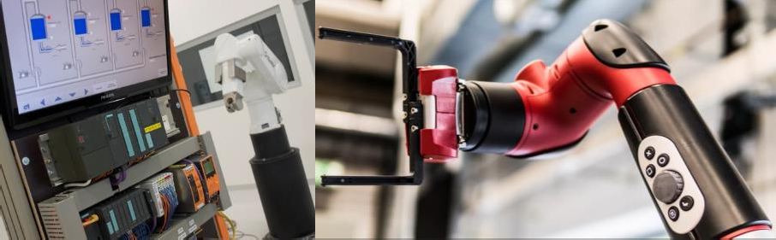

TECHNOLOGY CAMPUS
CHAM
Design and Simulation of a PID Controller for Precise DC Motor Speed Control
Prof: Sunil P. Survaiya
Cham, 09.06.2026

Slide 3




Group Members
Praveen Kumar Cheerla
- 12501601
Gamini Lokesh Chowdary -12652811
Ameer khan Mohammed - 12659875
Ajith Kannan karipody -12600349
07.05.2026
3

Slide 4



Transition: "Why we need Closed-Loop PID Control:
Feedback Architecture
Error-Driven Logic: By feeding back the Angular Velocity (𝜔), we create an Error Signal (e =
Lack of Awareness: In an open-loop configuration, the system has no knowledge of its actual output (Angular Velocity). It blindly follows the input voltage.
Disturbance Sensitivity: Any external factor—such as the 0.01 Nm Load Torque we applied—results in a permanent steady-state error or system stall.
Parameter Drift: If internal resistance
(R) increases due to heat, an open-loop system cannot adapt, leading to speed degradation.
Open-Loop Vulnerability
𝜔 - 𝜔 ). The controller now
ref act
works to drive this error to zero.
Active Compensation: The PID controller "senses" the load-induced drop and automatically increases the Armature Voltage (V_{a}) to compensate.
07.05.2026
4

Slide 5
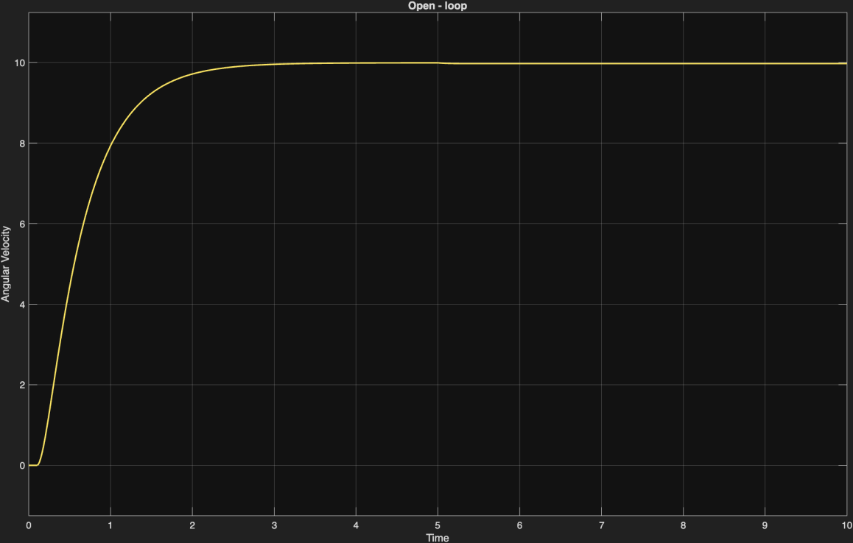
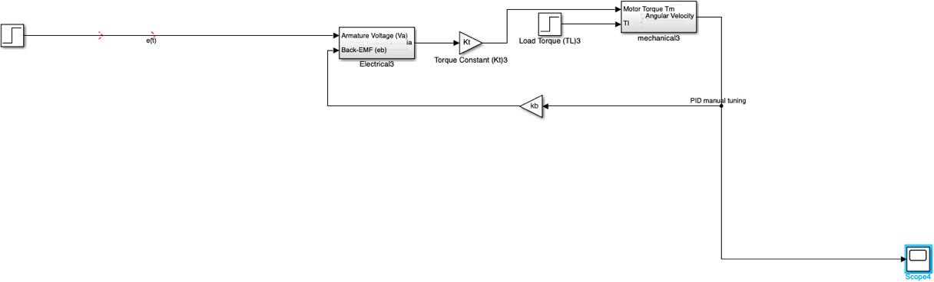
5/7/2026
5

Slide 6
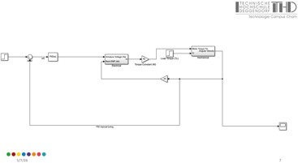
Implementing the PID:
Component | The "Temporal" Role | Physical Impact on the Motor
Proportional (K_{p}) | The Present | Reacts to the current error. High K_{p} makes the motor reach the target faster but can cause instability.
Integral (K_{i}) | The Past | Accumulates past errors. This is the only term that can eliminate the "droop" caused by friction (B) and Load Torque (T_{L})
Derivative (K_{d}) | The Future | Predicts future error by looking at the "slope." It acts as a brake to prevent the motor from overshooting the target.
Closing the Loop: The Logic Flow
The feedback wire carries the Angular Velocity back to the start.
Sense
The Summing Junction subtracts the actual speed from the target speed to find the "Error."
Compare
The PID Block calculates how much voltage is needed based on the size of that error.
Process
The calculated voltage enters the Electrical Subsystem, which generates current, which creates torque, which changes the speed.
Act
07.05.2026
6

Slide 7
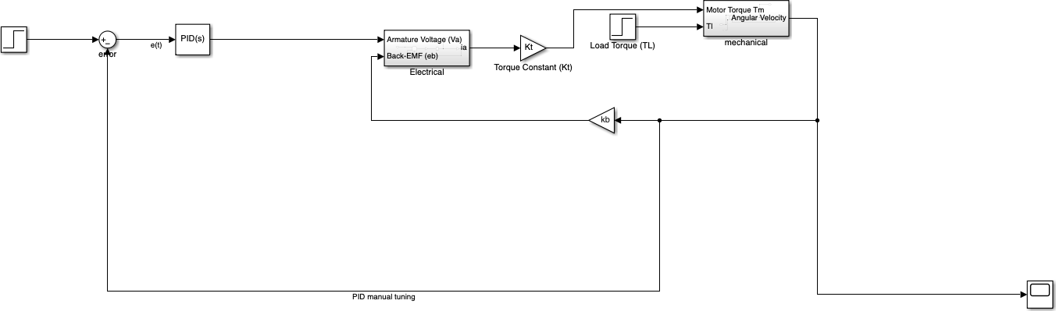
5/7/2026
7

Slide 8
Controller Performance Metrics & Evaluation:
Transient Response Metrics
Rise Time (T_{r}): The time required for the speed to go from 10% to 90% of the target (e.g., reaching 90
rad/s).
Significance: Indicates the responsiveness and "aggressiveness" of the motor.
Peak Overshoot (M_{p}): The maximum percentage by which the speed exceeds the setpoint (100).
Significance: Excessive overshoot indicates poor damping and can cause mechanical gear wear or shaft fatigue.
Settling Time (T_{s}): The time it takes for the oscillations to stay within a small error band (usually +\- 2%).
Significance: Defines how quickly the system becomes "stable" and ready for task execution.
Steady-State Metrics
Steady-State Error (e_{ss}): The final difference between the desired 100 rad/s and the actual speed.
07.05.2026
8

Slide 9
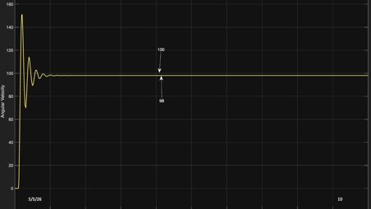
Heuristic Analysis: Manual Tuning & Offset Issues
The Steady-State Error
The final difference between the target and the actual output as time approaches infinity
By setting the Integral (I) gain to 0, the output will settle blow 100
The Physics: Without the Integral term, the controller doesn't have a "memory" of the error. It provides voltage based only on the current difference (P) and the speed of change (D). Once the motor gets "close enough" to 100, the friction (B) and Back-EMF (e_{b}) balance out the control effort, and the system stops climbing.
This "gap" is the Steady-State Error
9

Slide 10
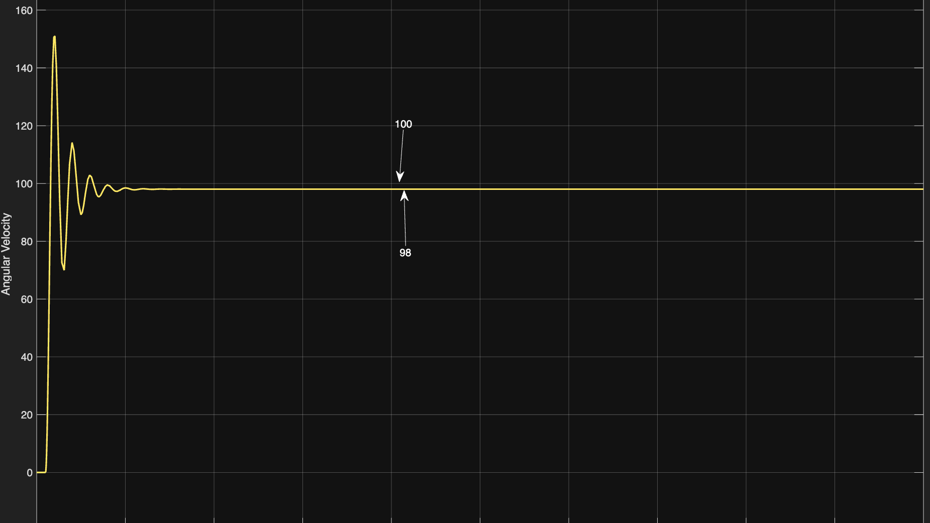
5/7/2026
10

Slide 11
System Computational Optimization (PID Auto-Tuning)
Objective
Auto-tuning is the process of algorithmically determining the K_{p}, K_{i}, and K_{d} gains to achieve a specific Target Response. Unlike manual "trial and error," this method uses the Plant's Frequency Response to balance speed and stability.
Small-Signal Linearization
Linearization: It treats your KVL and Newton-Euler subsystems as a unified
mathematical model.
Frequency Domain Analysis: It analyzes the "Phase Margin" and "Gain Margin" to ensure the system doesn't oscillate uncontrollably.
Cost Function: It attempts to minimize a "Cost Function" where it weighs Settling Time against Overshoot.
07.05.2026
11

Slide 12
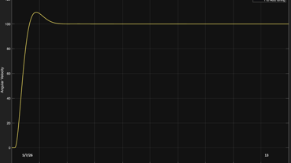
System Computational Optimization (PID Auto-Tuning)
Advantages of the Auto-Tune Method
Optimal Balance: It finds the "Critically Damped" state—the fastest possible rise time with zero or minimal overshoot.
Robustness: It calculates a "Stability Margin." This means even if motor's resistance (R) changes slightly due to heat, the controller stays stable.
Efficiency: It replaces hours of manual heuristic tuning with a mathematically guaranteed solution based on the Digital Twin's specific parameters (L, R, J, B).
Parameter | Observed Value | Technical Significance
Setpoint (Target) | 100 rad/s | The desired steady-state angular velocity.
Peak Amplitude | ~109 rad/s | The highest value reached during the transient phase.
Overshoot (M_{p}) | ~9% | Calculated as ((109 - 100) / 100) *100. Excellent for motor safety.
Rise Time (T_{r}) | ~0.65 s | The time taken to climb from 10% to 90% of the setpoint.
Settling Time (T_{s}) | ~1.8 s | The time required to stay within 2% of the final 100 rad/s target.
Steady-State Error (e{_{ss}}) | 0% (Zero) | Confirms that the Integral gain (K_{i}) is perfectly tuned.
07.05.2026
12

Slide 13
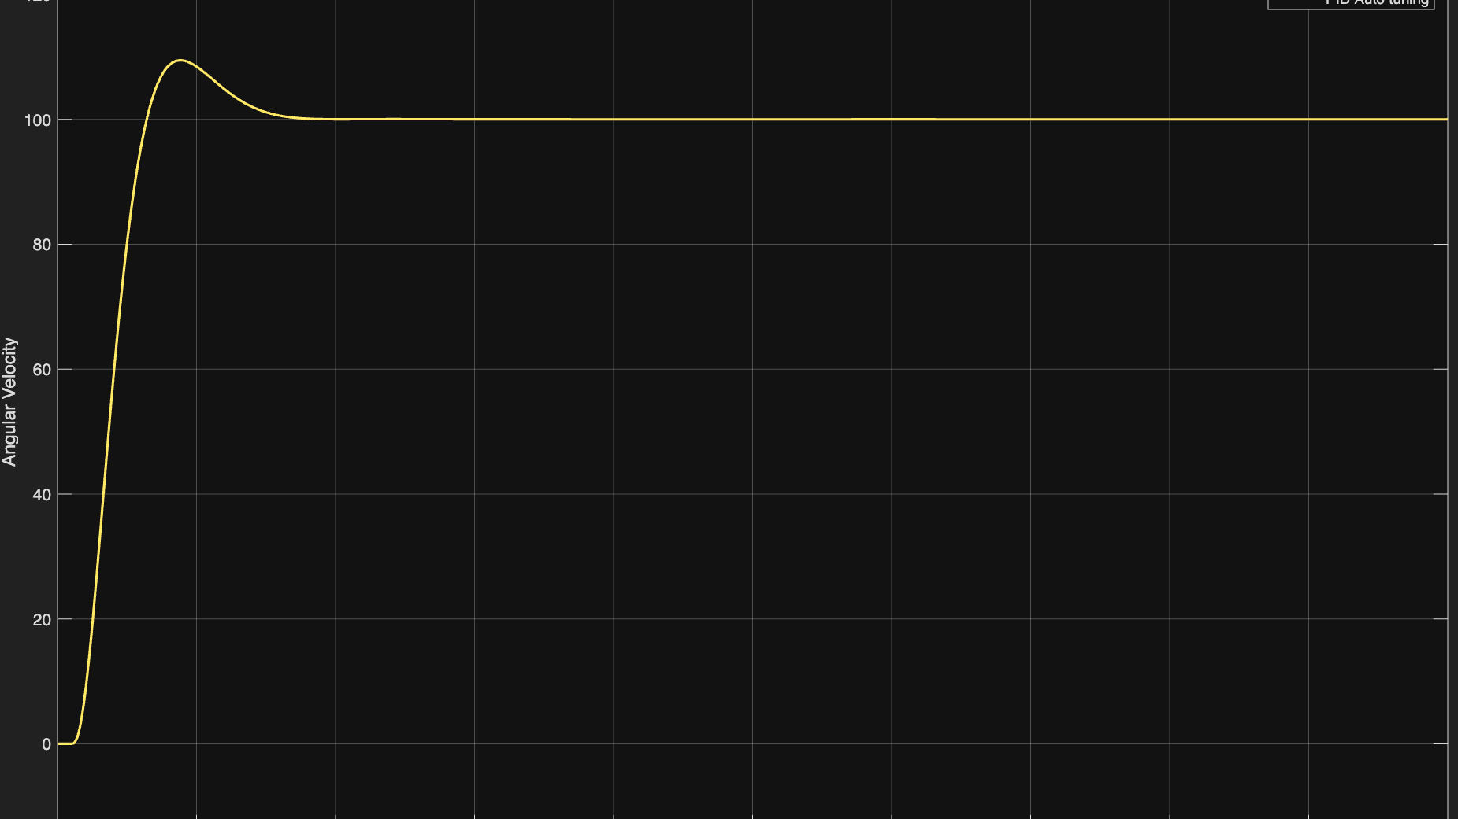
5/7/2026
13

Slide 14
Conclusion
The case study successfully demonstrates the design and optimization of a DC Motor Digital Twin. By transitioning from an unregulated Deterministic Plant to a Closed-Loop PID Architecture, we achieved total setpoint tracking at 100 rad/s.
Comparative analysis reveals that while heuristic manual tuning provides a safety baseline, computational Auto-Tuning yields the superior stability margin (60⁰ Phase Margin). Furthermore, the model’s ability to reject a 0.002 Nm load disturbance confirms its high fidelity and readiness for real-world robotic implementation.
Tuning Method | Rise Time (Tr) | Overshoot (Mp) | Steady-State Error (ess) | Verdict
Manual (P-only) | Slow | 0% | High (Offset) | Inadequate for precision tasks.
Ziegler-Nichols | Fastest | ~20% | Zero | Efficient but risks mechanical stress.
Auto-Tune | Balanced | ~9% (Optimal) | Zero | Best performance for the Digital Twin.
07.05.2026
14

Slide 15

Project: Design and Simulation of a PID Controller for Precise DC Motor Speed Control
Group members: Date: 09-06-2026
Work completed /Status:
Discussion Required:
Topic selected: PID Controller Simulation for DC Motor (MATLAB/Simulink)
Problem statement defined
DC Motor mathematical model studied (electrical + mechanical equations)
PID theory reviewed (P, I, D terms and control law)
Simulink model structure planned
Tuning methods identified (Manual, Ziegler-Nichols, Auto-tune)
Concept presentation slides prepared
Build the DC Motor transfer function in Simulink
Implement the PID Controller block in closed-loop
Implemented PID Manual with I=0 and Auto-tune methods
Project Requirements:
Next Steps:
MATLAB R2023a or later (with Simulink)
Control System Toolbox
Standard PC/Laptop ( simulation only)
Apply all Ziegler-Nichols and manual tuning methods and run simulations
Record step response, settling time, overshoot, steady-state error
Compare results across tuning methods
07.05.2026
15

Slide 16
THANK YOU

